Slide 1
Nigiwai

Slide 2
About VADER
Continuing learning how to make new scenarios.
I created many scenarios to compare between them
In this presentation, there are many data and many comparisons (sorry for distracting)

Slide 3

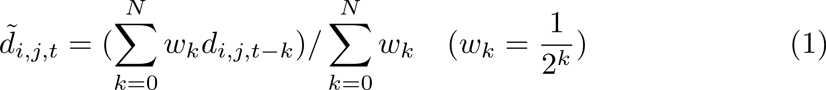

Absolute vs signed relative velocity
Remembering in the previous meeting, something abnormal about the Nigiwai score especially when objects are converged.
Still using
I created a simple scenario with two pedestrians.
Noting from frame 40:49 the two pedestrian are converged, but nigiwai score is not increase.
So, I register the distance between them and the Nigiwai score at each frame. (Excel sheets)

Slide 4
Absolute vs signed relative velocity
I found that the problem comes when taking N previous frames (N=10), the resultant distance is far from the current one.
i.e, taking long history (10 frames) does not give accurate indication for the current distance.
I think in case of simulation trajectories (VADERE), they are smooth and no need for take moving average (or maybe we take only 3 frames).

Slide 5

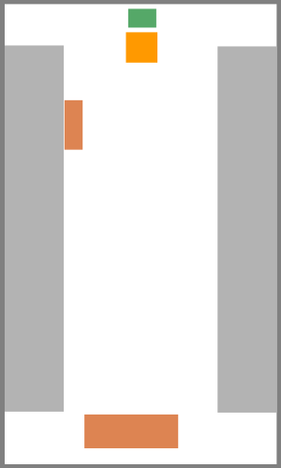
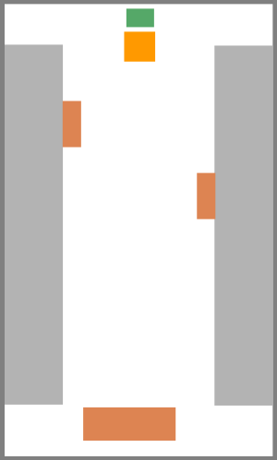
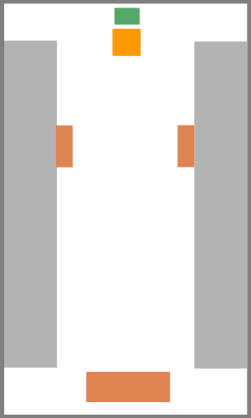
Several scenarios
Only passing
One shop
Two shops
Two shops2, moving between
I created many scenarios, all of them are the same size, the same source rate (with a total of 150 Ped.).

Slide 6
Nigiwai score
120.21
236.18
231.59
301.02
Only passing
One shop
Two shops
Two shops, moving between
Each created video shows frame No, current number of pedestrian and the summation of Nigiwai score per frame. (Nigiwai score X 1000 for displaying )
Finally, the accumulated Nigiwai score during the whole video is shown at each scenario.

Slide 7
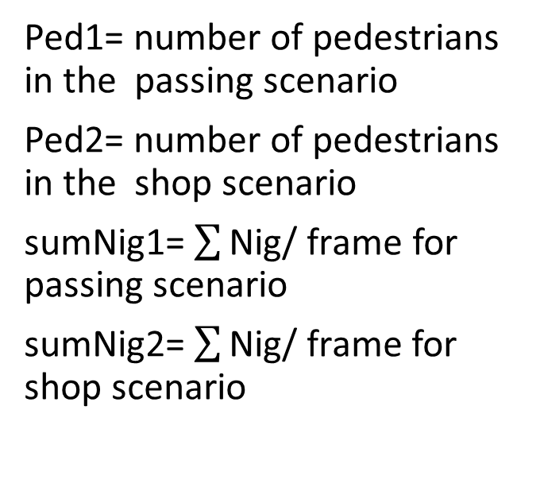
Analysis
A comparison between the “only passing” and “two shops2” scenarios is achieved according to change of the Number of pedestrians and Nigiwai score (per frame) with time.
Ped1= number of pedestrians in the passing scenario
Ped2= number of pedestrians in the shop scenario
sumNig1= $\sum{\text{Nig}\text{/ }\text{frame}}$ for passing scenario
sumNig2= $\sum{\text{Nig}\text{/ }\text{frame}}$for shop scenario

Slide 8
Analysis
Although the rate of pedestrian entering is the same in the two scenarios, the density in the Shop scenario is higher.
Also, the Nigiwai score is higher in the Shop scenario
But we need also, to compare the Nigiwai score in case of similar density.

Slide 9
Analysis and comparisons
In the excel sheet, ‘passing_Vs_twoshops2.xlsx’, I made many comparisons between ‘Passing’ and ‘Two shops2’ scenarios.
I tried to increase the density (No of ped per frame) in case of Passing scenario by increasing the entering rate.
After many trials, ‘sheet 5th comp ’, I found that by increasing the entering rate so the total 240 Ped in ‘Passing’ scenario vs 150 Ped in ‘Two shops2’ scenario, the density are similar.
However their Nigiwai also, become similar.

Slide 10
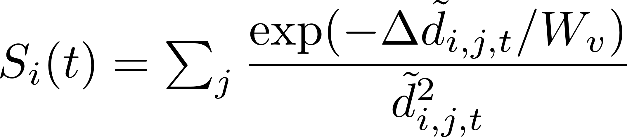
Analysis and comparisons
In the next trial I used W_{v} =1, so the Nigiwai score becomes distinguishable between ‘Passing’ and ‘Two shops2’ scenarios ’sheet Wv=1’
Then, I compare ‘Passing’ vs ‘one shops’ scenarios, also Nigiwa score is distinguishable. passing_Vs_OneShop.xlsx

Slide 11
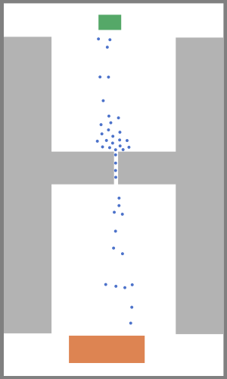
More scenario
OK, the previous slide results encourage me to make a new scenario of only Passing but with a congestion due to small Exit.
I make two comparisons with this scenario:
comparison with one shop with decrease entering rate for passing (133 total Ped) vs (150 ) in one shop passing_Vs_OneShop.xlsx
comparison with Two shops2 with same entering rate passing_Vs_twoshops2.xlsx
In case of Two shops2 the Nigiwai score is obvious larger which is promising result
But in one shop no

Slide 12
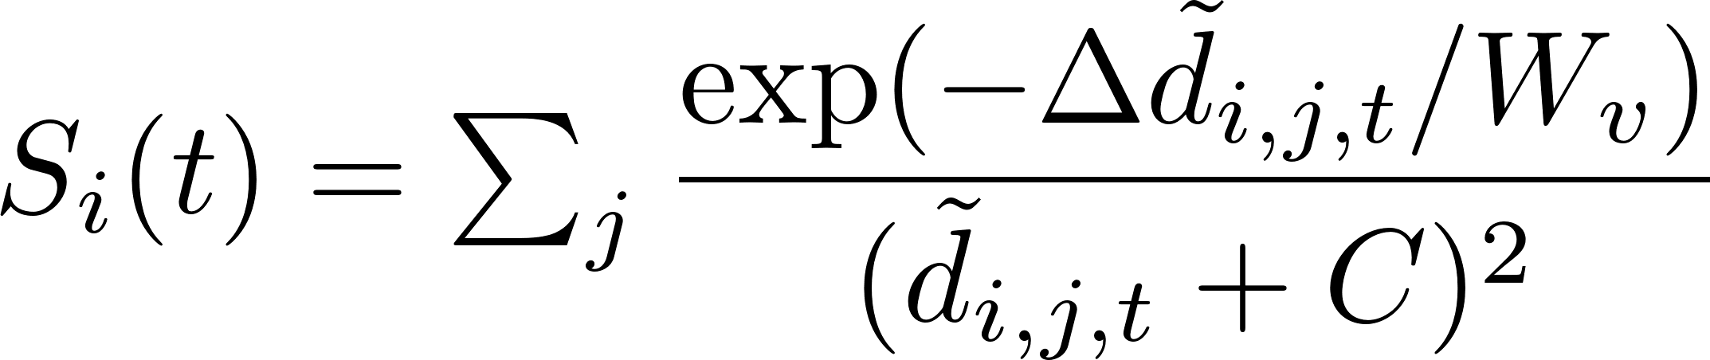
new formula for the moving average
Apply new formula and comparing between different scenario
passing_Vs_Shop_Alpha.xlsx

Slide 13
Conclusion
In the old form, N high affects in the determining of moving average distance, and also (α) in the new form.
Wv affect in determining Nigiwai indicator.
I try to make similar density between “Passing” and “shopping”videos by changing entering rate
The summation of Nigiwai of “one shop” and “Two shop” videos is greater than “Passing video” (in both new and old formula)
The summation of Nigiwai of “Two shop” video is greater than “passing with congestion” video but in “one shop” video not.

